Slide 1
Automated Papadam Maker
Group No: 37

Slide 2
Group Members
B.R.C.Perera – 174114B
S.M.D.R.N.Senaratne – 174152M
B.I.T.Keerthiratne – 174074B
G.Kalairaj – 174065A
R.Kajaroopan - 174064U

Slide 3
Aim and Objectives
Aim
Our aim is to introduce a more effective and easy way to produce Papadam, which requires minimum human intervention. We are developing a device which can be used for industrial aid when making Papadam.
Objectives
Structure the most effective design for the product.
Build the kneading component separately. It features a mixing bowl and a customized hook that would be used for mixing the dough evenly.
Build a mechanism to roll out the dough into a flat spread.
Build a mechanism to roll out disks from the dough.
Build a drying mechanism in which the dough can be left to dry in near environmental conditions.

Slide 4
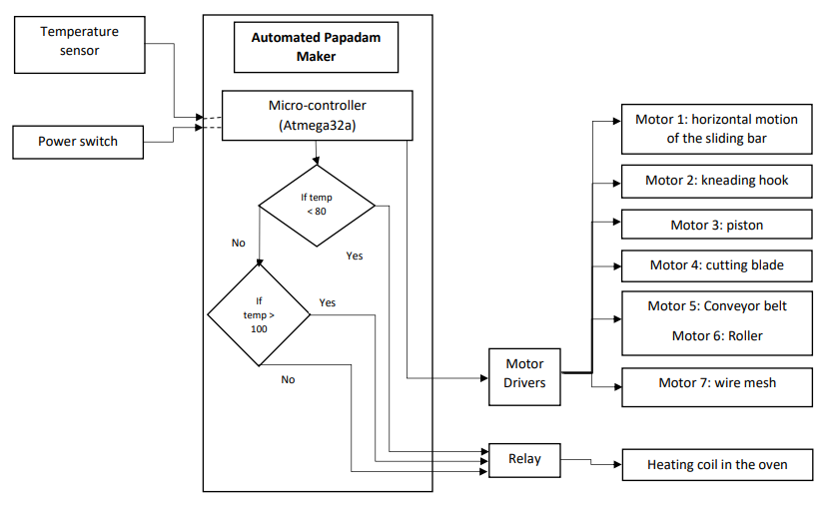
System Block Diagram

Slide 5
System Diagram
Ingredients (Udu flour, baking powder, salt, water)
The potion of dough falls onto the conveyor belt and is flattened.
The mesh is lowered into the oven.
Mix the ingredients in the kneading compartment with the mixer.
The flattened dough falls onto the mesh inside the oven.
The heating coil is activated.
The mixer rises out and moves so the piston is placed above the cylinder.
If temp < 80
NO
NO
YES
If temp > 100
Switch on the heating coil.
The piston pushes down, thus compressing the dough until it comes out through the small hole.
YES
Switch off heating the coil.
The next motor moves the blade at the bottom of the cylinder which cuts the dough into small potions.
Dry Papadam

Slide 6
Total Cost
Component | Price
Motors | 5800
Overall hardware structure | 9600
Motor drivers and other electrical components | 3900
Relay modules | 190
PCB | 600
Temperature sensor | 260
LCD display | 310
Heating coil | 3200
Total Cost | 23,860

Slide 7
Thank you.

Slide 8
PCB Diagram

